Slide 1

Sentiment Analysis of Twitter Data for predicting Apple stock price
Group4
Amit Sharma, Mihir Mehta, MANJARI SHUKLA, Richard Yoo
Notes:
Welcome!
Today, our group wants to present “Title”
This will be interesting so don’t lose focus!

Slide 2
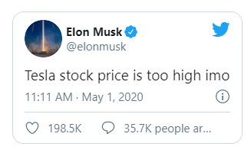


WHY Twitter?
Core Message
To analyze how Twitter sentiment affects the price of Apple stock (“AAPL”)
Twitter is a rich source of real-time information regarding current societal trends and opinions.
Notes:
So as you might already know from our title, core message that we are trying to deliver is Blah Blah
Any Why Twitter? Blah Blah.
For example, a couple of months ago, Elon Musk tweeted and said Blah…
This was when Tesla stock was $781.88 and TSLA stock fell 4.46% as a result of this tweet.
So now you know how Twitter sentiment can affect the price of various stocks. Let us explain what kind of data and models that we used.

Slide 3





Data & Models
Twitter Data: Data from Kaggle (https://www.kaggle.com/nadun94/twitter-sentiments-aapl-stock)
Stock Data: Stock Price of Apple from Yahoo Finance from Jan 01, 2016 to Aug 31, 2019.
Machine Learning Models: LSTM, Random Forest, XG Boost and Gradient Boost to fit the data, make predictions and compare performance between models.
Data Visualization: hvPlot and Matplotlib.
Notes:
This includes ts_polarity and twitter_volume, date starting from January 01, 2016 to August 31, 2019

Slide 4
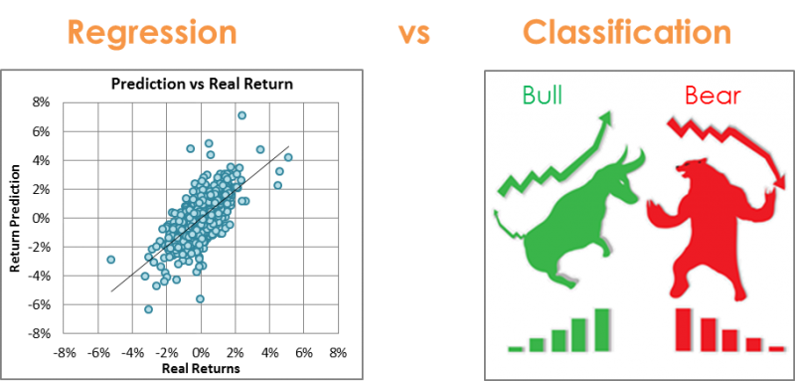
Source : https://www.kaggle.com/anniepyim/essential-classification-algorithms-explained

Slide 5
Methodology:
A rolling windows-based regression method was used on adjusted closing prices for Apple stock.
The 3 previous day prices were used as features and the 4th day price as the target vector.
Twitter polarity scores and volume were also used as features.
Methodology:
The adjusted closing price for Apple stock was converted into binary form based on the difference in current price vs previous day price.
This was done to analyze the trend in the market with a rise represented as 1 and a fall in price represented as 0.
Twitter polarity scores were used to classify tweets into positive, negative and neutral sentiments. Binary encoding of these sentiments was used to run the classifier models.
Models:
LSTM RNN
Random Forest Regressor
XG Boost Regressor
Models:
Random Forest Classifier
Gradient Booster

Slide 6
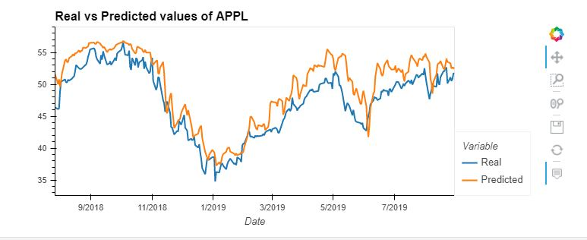
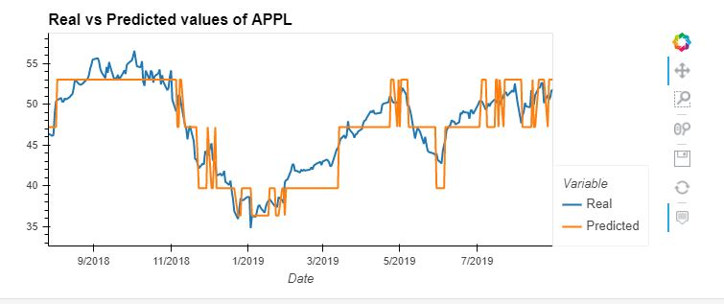
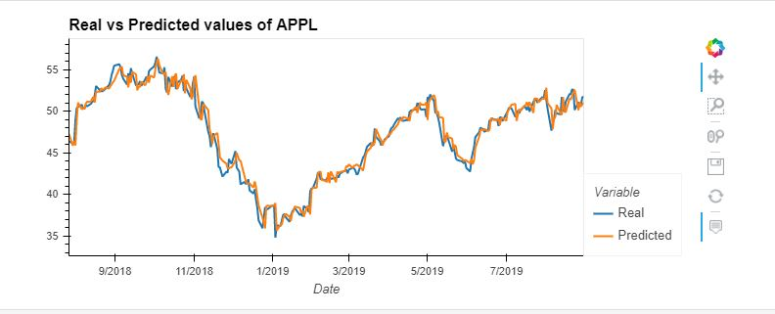
KEY FINDINGS <Regression Approach>
LSTM
R-Squared : 68.01%
RMSE : 0.1334
LSTM
Random Forest Regressor
XG Boost
RF Regressor
R-Squared : 82.27%
RMSE : 0.0993
XG Boost
R-Squared : 95.92%
RMSE : 0.0477

Slide 7
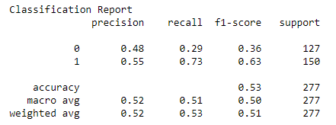
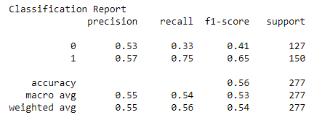
KEY FINDINGS <Classification Approach>
RF Classifier
Random Forest Classifier
Gradient Booster
Gradient Booster

Slide 8
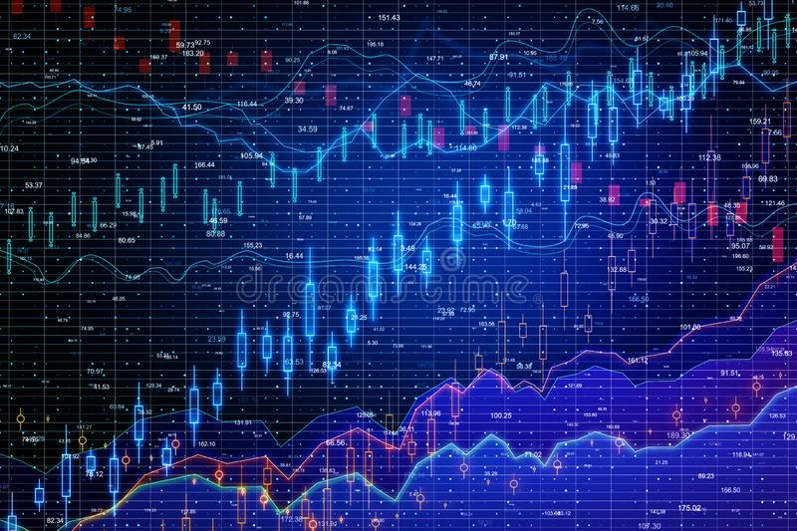
Summary
The regression approach turned out to be a better approach for predicting apple stock price as opposed to the classification approach.
This project shows that there is evidence of dependence between stock price and twitter sentiment.
However, this needs to be further investigated to accurately forecast a connection between social media and market behavior.

Slide 9



Problems/Issues during data preparation and model training
Data preparation:
1) Getting AAPL stock data
2) Getting Twitter Data with “ts_polarity” and “twitter_volume”
3) Getting Twitter Data using Tweepy Library
Model Training:
Identifying optimum hyperparameters to fine tune the model outputs

Slide 10
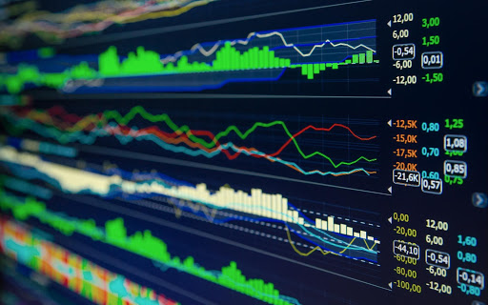
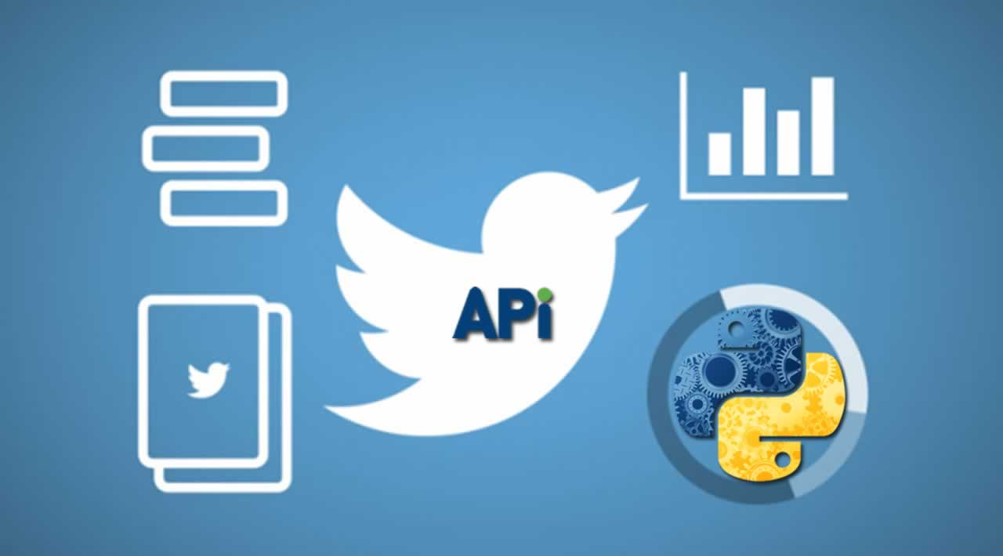

Postmortem
If we had 2 more weeks!!
Tweepy API/Library
News API headlines besides Twitter
New API/Libraries
More Machine Learning Models
More Visualizations
More Stocks/Market

Slide 11


